Slide 1



Nearly Kähler geometry and totally geodesic submanifolds
Juan Manuel Lorenzo Naveiro
CITMAGA – Universidade de Santiago de Compostela
Differential Geometry Seminar, The University of Adelaide
May 31, 2024
Joint work with Alberto Rodríguez-Vázquez (KU Leuven)

Slide 2
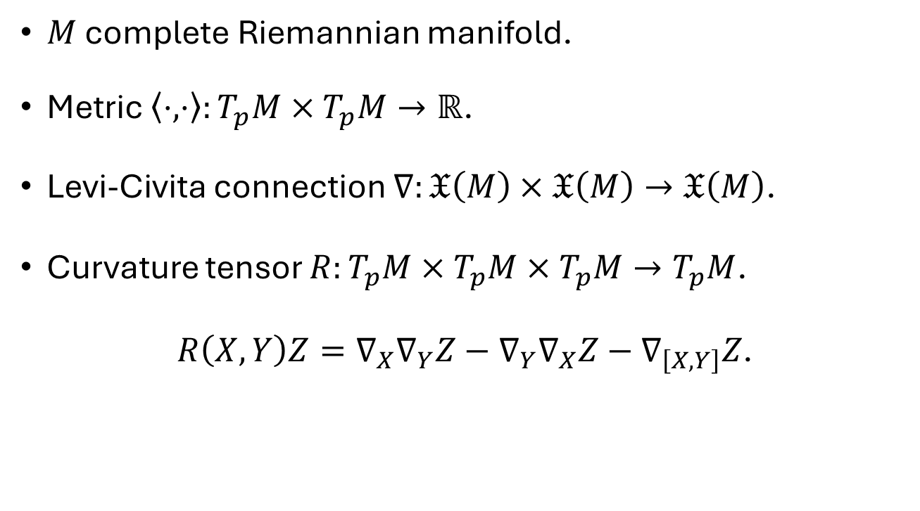
Preliminaries
$M$ complete Riemannian manifold.
Metric $⟨⋅,⋅〉:T_{p}M×T_{p}M→ℝ$.
Levi-Civita connection $∇:𝔛\left(M\right)×𝔛\left(M\right)→𝔛\left(M\right)$.
Curvature tensor $R:T_{p}M×T_{p}M×T_{p}M→T_{p}M$.
$R\left(X,Y\right)Z=∇_{X}∇_{Y}Z−∇_{Y}∇_{X}Z−∇_{\left[X,Y\right]}Z$.

Slide 3
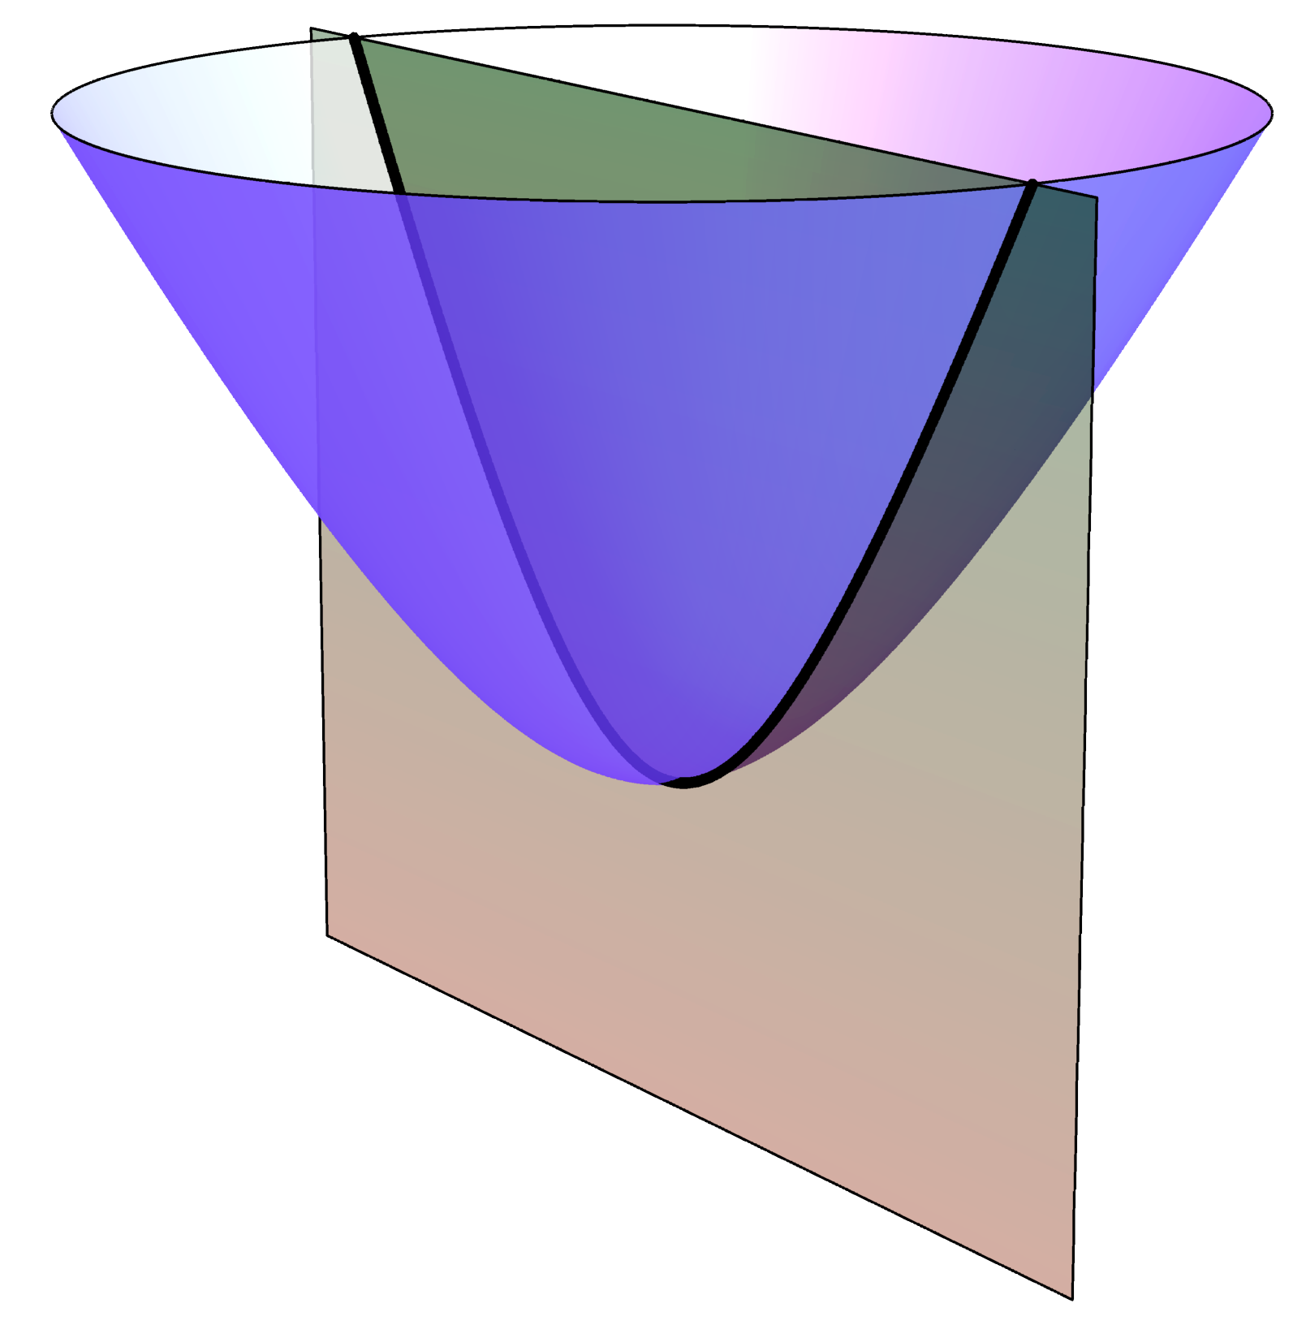
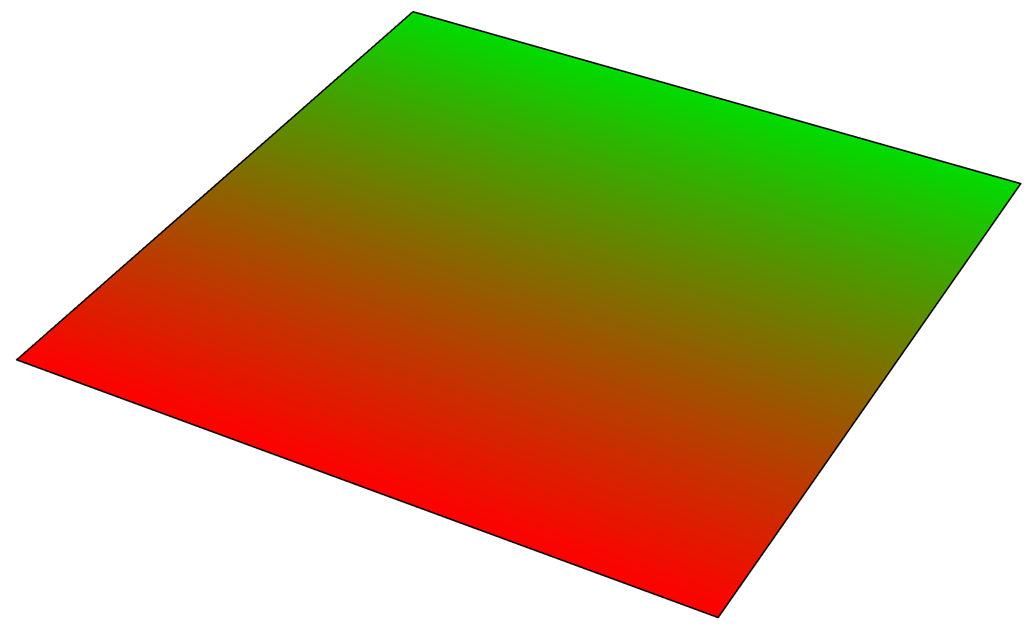
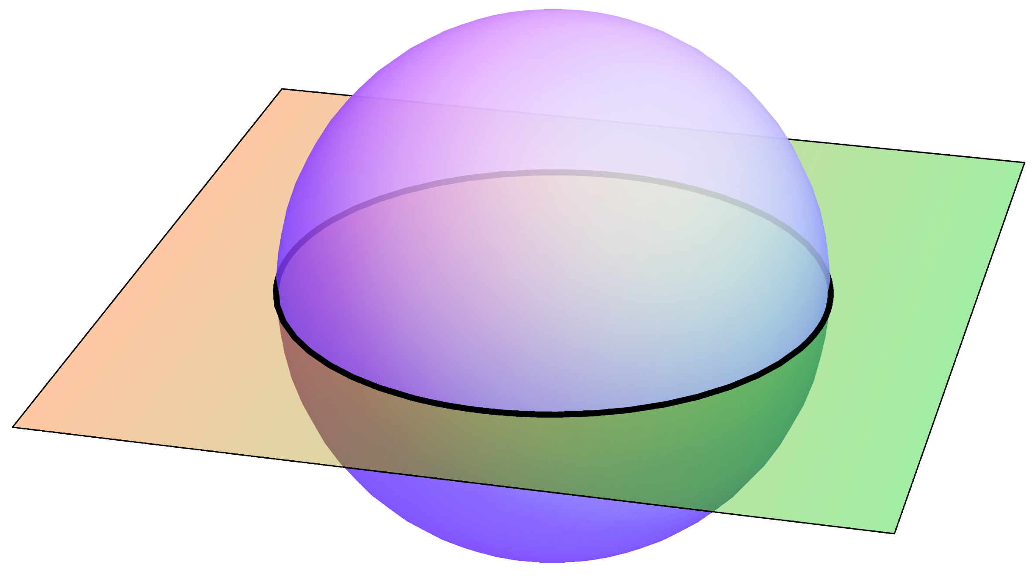
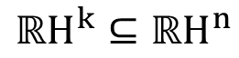
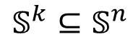
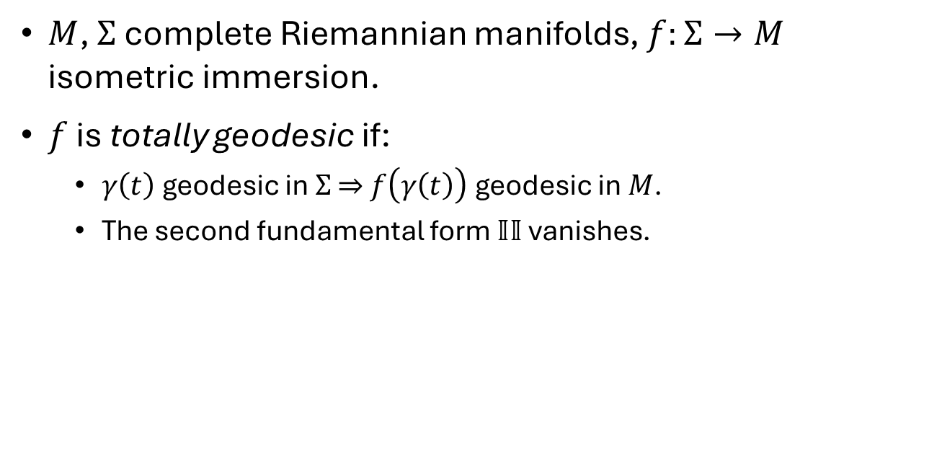
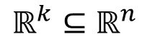
Totally geodesic submanifolds
$M$, $Σ$ complete Riemannian manifolds, $f:Σ→M$ isometric immersion.
$f$ is totally geodesic if:
$γ\left(t\right)$ geodesic in $Σ$ $⇒$ $f\left(γ\left(t\right)\right)$ geodesic in $M$.
The second fundamental form $𝕀𝕀$ vanishes.
$$ℝ^{k}⊆ℝ^{n}$$
$$𝕊^{k}⊆𝕊^{n}$$
$${ℝH}^{k}⊆{ℝH}^{n}$$

Slide 4
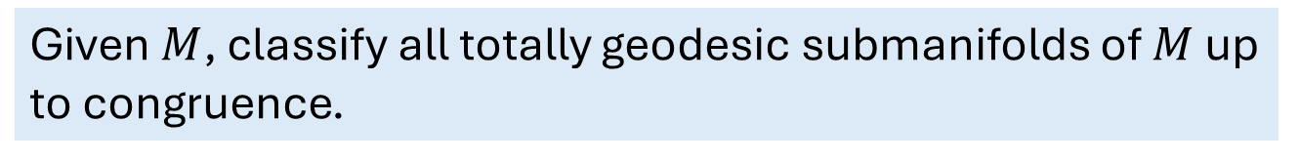
Totally geodesic submanifolds
$M$, $Σ$ complete Riemannian manifolds, $f:Σ→M$ isometric immersion.
$f$ is totally geodesic if:
$γ\left(t\right)$ geodesic in $Σ$ $⇒$ $f\left(γ\left(t\right)\right)$ geodesic in $M$.
The second fundamental form $𝕀𝕀$ vanishes.
General problem
Given $M$, classify all totally geodesic submanifolds of $M$ up to congruence.

Slide 5
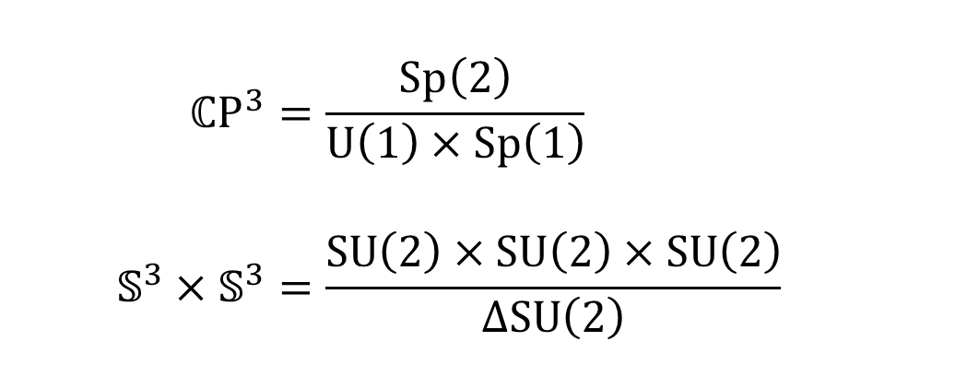
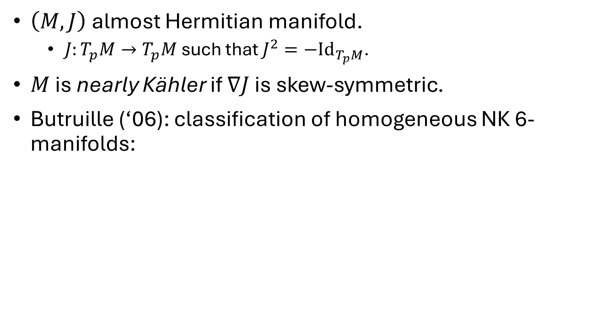
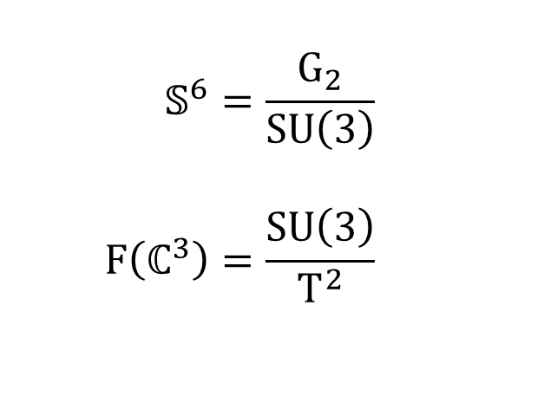
Nearly Kähler spaces
$\left(M,J\right)$ almost Hermitian manifold.
$J:T_{p}M→T_{p}M$ such that $J^{2}=−{Id}_{T_{p}M}$.
$M$ is nearly Kähler if $∇J$ is skew-symmetric.
Butruille (‘06): classification of homogeneous NK 6-manifolds:
$$𝕊^{6}=\frac{G_{2}}{SU\left(3\right)} \\ F\left(ℂ^{3}\right)=\frac{SU\left(3\right)}{T^{2}}$$
$$ℂP^{3}=\frac{Sp\left(2\right)}{U\left(1\right)×Sp\left(1\right)} \\ 𝕊^{3}×𝕊^{3}=\frac{SU\left(2\right)×SU\left(2\right)×SU\left(2\right)}{ΔSU\left(2\right)}$$

Slide 6
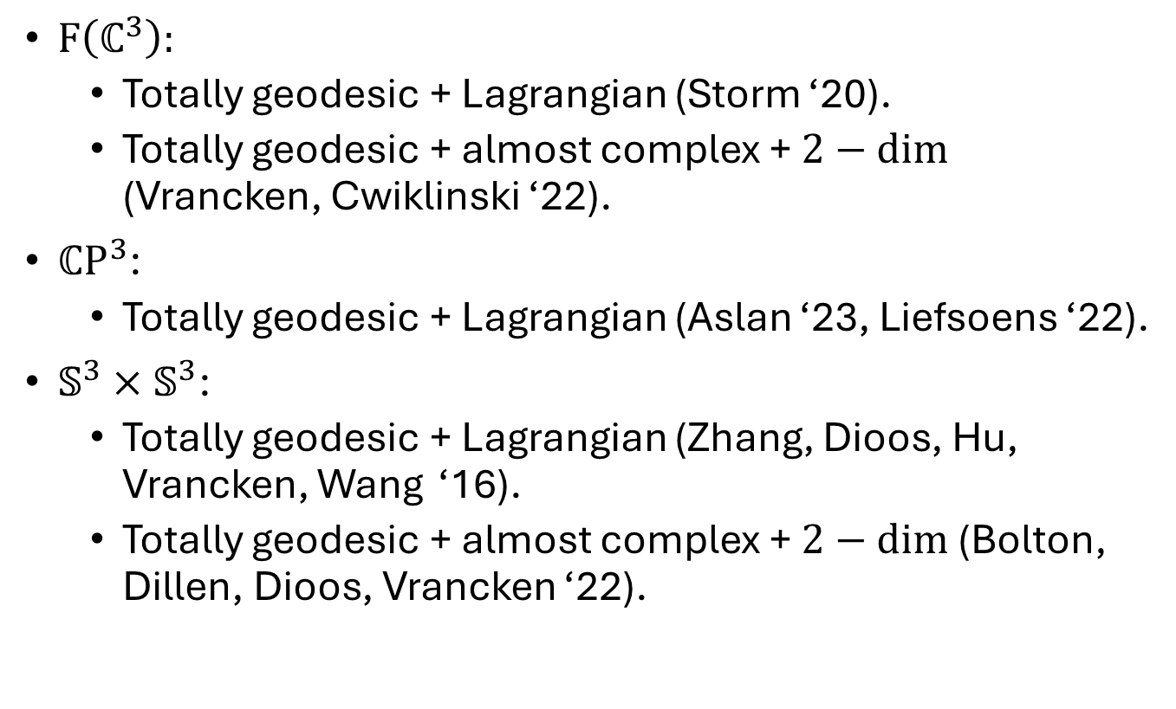
Previously known results
$F\left(ℂ^{3}\right):$
Totally geodesic + Lagrangian (Storm ‘20).
Totally geodesic + almost complex + $2−dim$ (Vrancken, Cwiklinski ‘22).
$ℂP^{3}$:
Totally geodesic + Lagrangian (Aslan ‘23, Liefsoens ‘22).
$𝕊^{3}×𝕊^{3}$:
Totally geodesic + Lagrangian (Zhang, Dioos, Hu, Vrancken, Wang ‘16).
Totally geodesic + almost complex + $2−dim$ (Bolton, Dillen, Dioos, Vrancken ‘22).

Slide 7
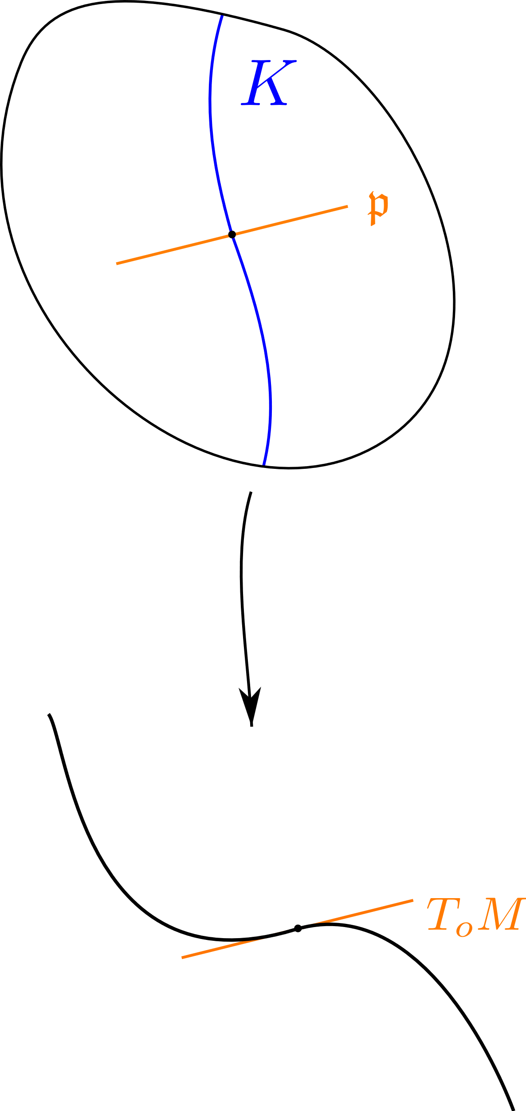
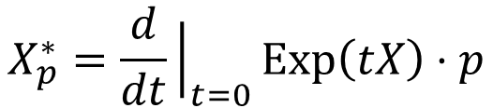
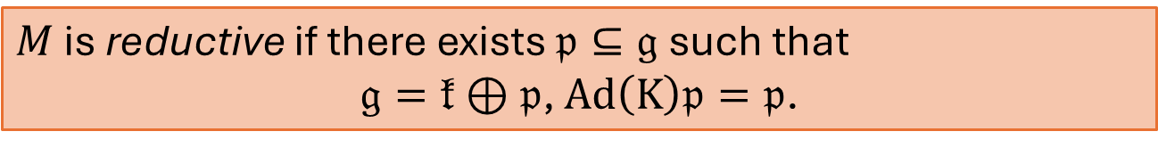
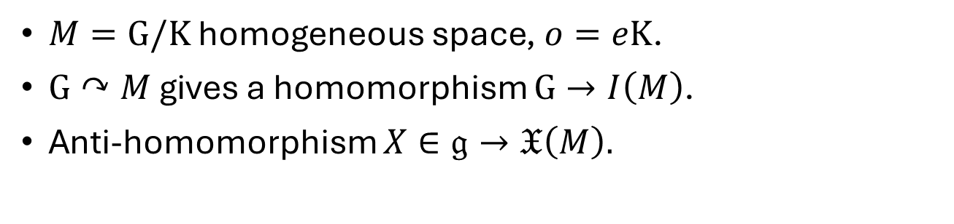
Reductive homogeneous spaces
$M=G/K$ homogeneous space, $o=eK$.
$G↷M$ gives a homomorphism $G→I\left(M\right)$.
Anti-homomorphism $X∈𝔤→𝔛\left(M\right).$
$$X_{p}^{∗}=\frac{d}{dt}{\left.​\right|}_{t=0}Exp\left(tX\right)⋅p$$
$T_{o}M=𝔤/𝔨$ via $X+𝔨↦X_{o}^{∗}$.
$M$ is reductive if there exists $𝔭⊆𝔤$ such that
$𝔤=𝔨⊕𝔭$, $Ad\left(K\right)𝔭=𝔭$.

Slide 8
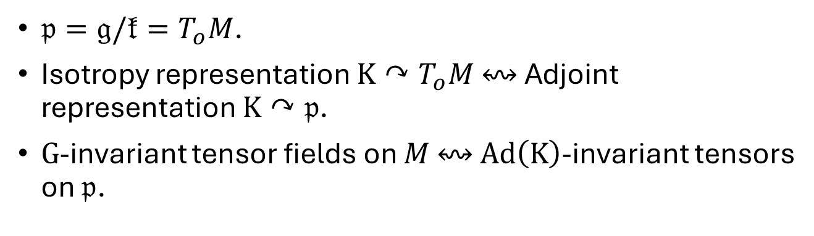

Reductive homogeneous spaces
$M$ is reductive if there exists $𝔭⊆𝔤$ such that
$𝔤=𝔨⊕𝔭$, $Ad\left(K\right)𝔭=𝔭$.
$𝔭=𝔤/𝔨=T_{o}M$.
Isotropy representation $K↷T_{o}M$ $↭$ Adjoint representation $K↷𝔭$.
$G$-invariant tensor fields on $M$ $↭$ $Ad\left(K\right)$-invariant tensors on $𝔭$.

Slide 9
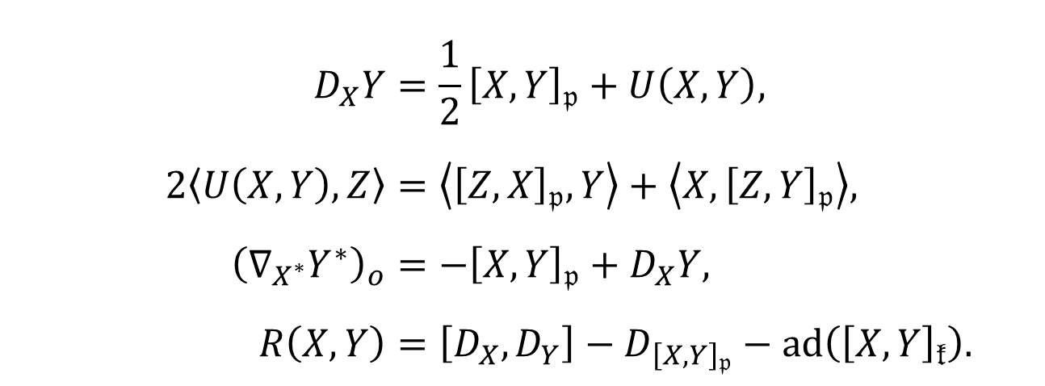
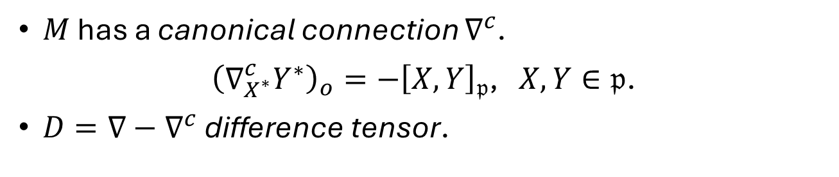
Connection and curvature
$M$ has a canonical connection $∇^{c}$.
${\left(∇_{X^{∗}}^{c}Y^{∗}\right)}_{o}=−{\left[X,Y\right]}_{𝔭}$, $X,Y∈𝔭$.
$D=∇−∇^{c}$ difference tensor.
$$D_{X}Y=\frac{1}{2}{\left[X,Y\right]}_{𝔭}+U\left(X,Y\right), \\ 2\left\langle U\left(X,Y\right),Z\right\rangle =\left\langle {\left[Z,X\right]}_{𝔭},Y\right\rangle +\left\langle X,{\left[Z,Y\right]}_{𝔭}\right\rangle , \\ {\left(∇_{X^{∗}}Y^{∗}\right)}_{o}=−{\left[X,Y\right]}_{𝔭}+D_{X}Y, \\ R\left(X,Y\right)=\left[D_{X},D_{Y}\right]−D_{{\left[X,Y\right]}_{𝔭}}−ad\left({\left[X,Y\right]}_{𝔨}\right).$$

Slide 10
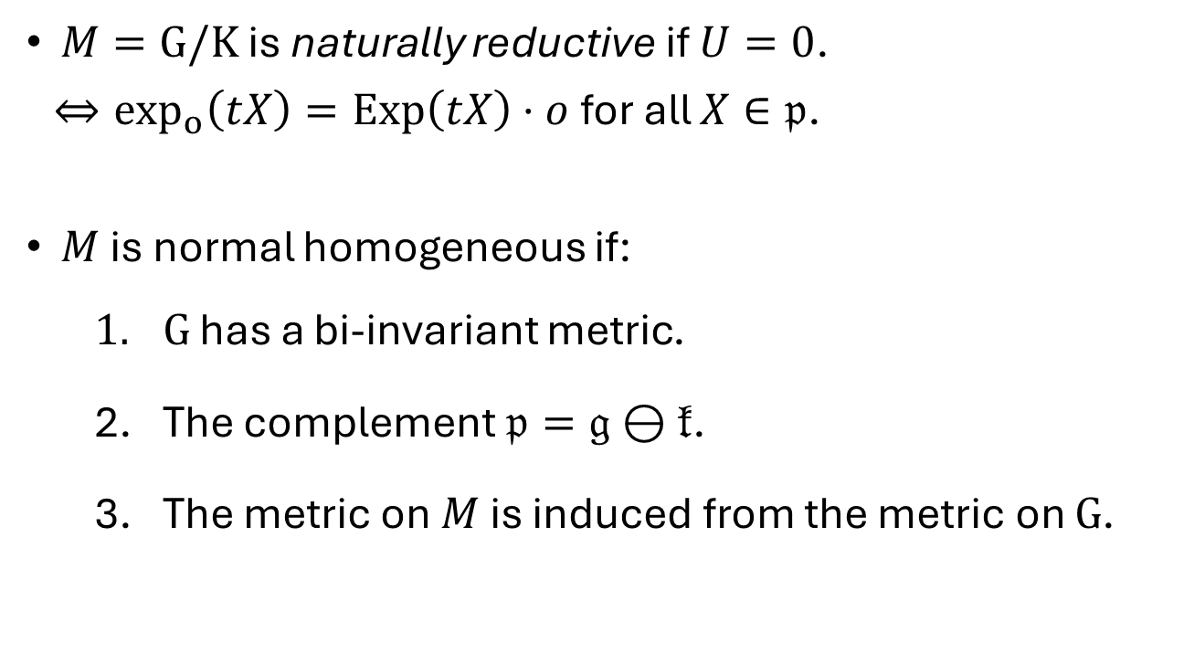
Natural reductivity
$M=G/K$ is naturally reductive if $U=0$.
$⇔\exp_{o}\left(tX\right)=Exp\left(tX\right)⋅o$ for all $X∈𝔭$.
$M$ is normal homogeneous if:
$G$ has a bi-invariant metric.
The complement $𝔭=𝔤⊖𝔨$.
The metric on $M$ is induced from the metric on $G$.

Slide 11
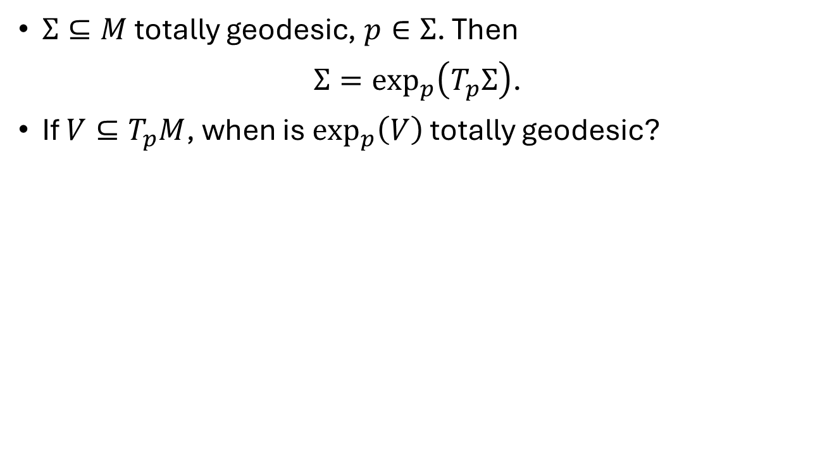
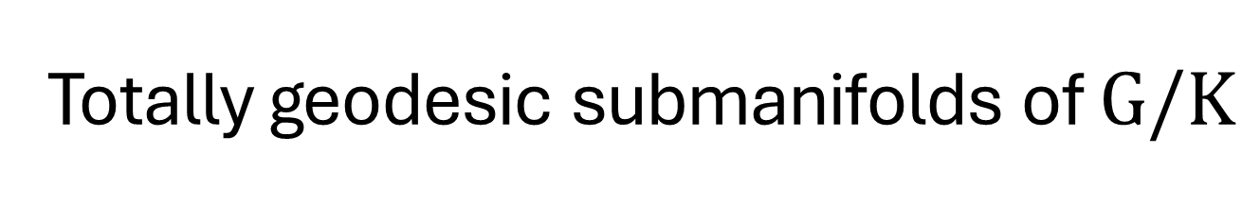
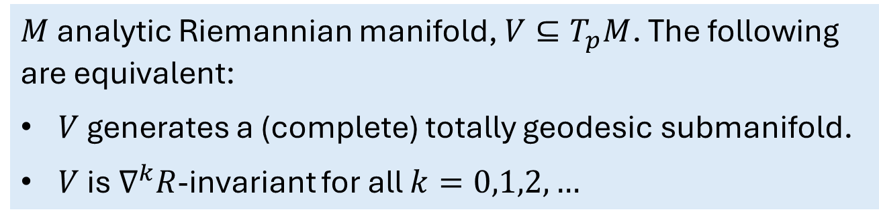
Totally geodesic submanifolds of $G/K$
$Σ⊆M$ totally geodesic, $p∈Σ$. Then
$Σ=\exp_{p}\left(T_{p}Σ\right)$.
If $V⊆T_{p}M$, when is $\exp_{p}\left(V\right)$ totally geodesic?
Theorem (Cartan ’51, Hermann ‘59)
$M$ analytic Riemannian manifold, $V⊆T_{p}M$. The following are equivalent:
$V$ generates a (complete) totally geodesic submanifold.
$V$ is $∇^{k}R$-invariant for all $k=0,1,2,…$

Slide 12
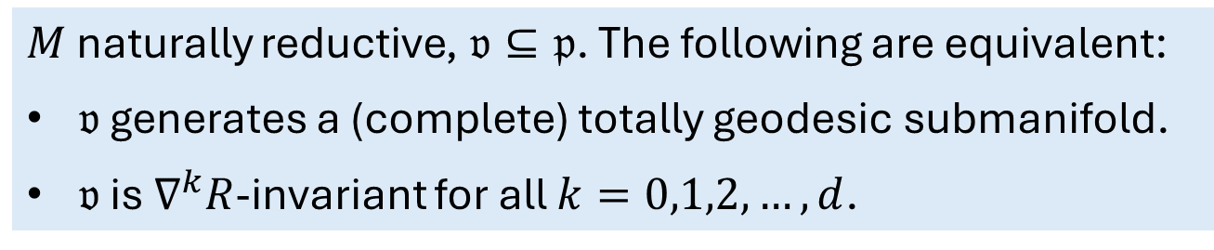
Totally geodesic submanifolds of $G/K$
$Σ⊆M$ totally geodesic, $p∈Σ$. Then
$Σ=\exp_{p}\left(T_{p}Σ\right)$.
If $V⊆T_{p}M$, when is $\exp_{p}\left(V\right)$ totally geodesic?
Theorem (Cartan) for naturally reductive spaces
$M$ naturally reductive, $𝔳⊆𝔭$. The following are equivalent:
$𝔳$ generates a (complete) totally geodesic submanifold.
$𝔳$ is $∇^{k}R$-invariant for all $k=0,1,2,…,d$.

Slide 13
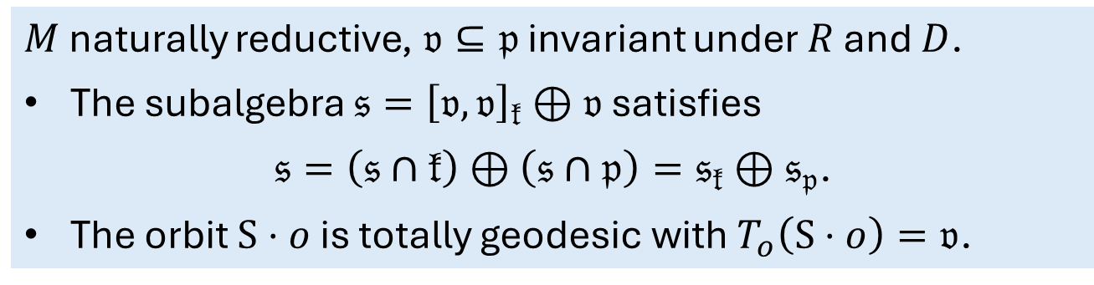
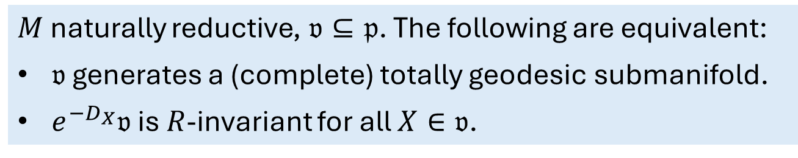
Tojo’s criterion (‘96)
$M$ naturally reductive, $𝔳⊆𝔭$. The following are equivalent:
$𝔳$ generates a (complete) totally geodesic submanifold.
$e^{−D_{X}}𝔳$ is $R$-invariant for all $X∈𝔳$.
Sufficient criterion (Sagle ‘68, LN—Rodríguez-Vázquez)
$M$ naturally reductive, $𝔳⊆𝔭$ invariant under $R$ and $D$.
The subalgebra $𝔰={\left[𝔳,𝔳\right]}_{𝔨}⊕𝔳$ satisfies
$𝔰=\left(𝔰∩𝔨\right)⊕\left(𝔰∩𝔭\right)=𝔰_{𝔨}⊕𝔰_{𝔭}$.
The orbit $S⋅o$ is totally geodesic with $T_{o}\left(S⋅o\right)=𝔳$.

Slide 14
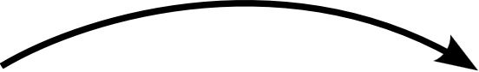
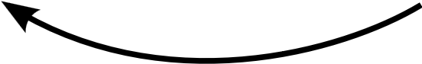
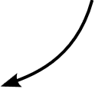
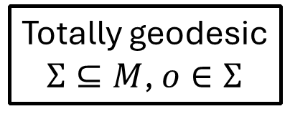
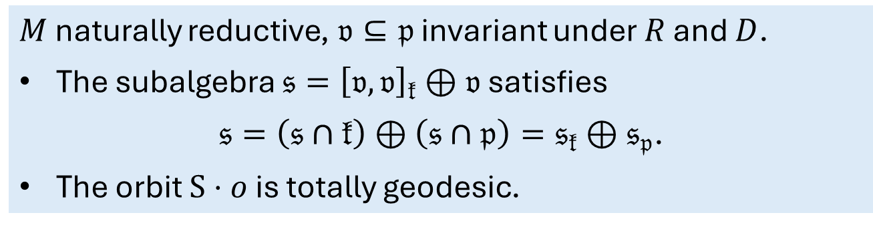
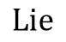
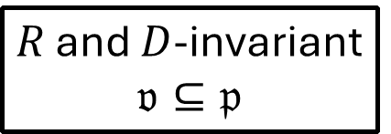
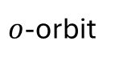
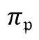
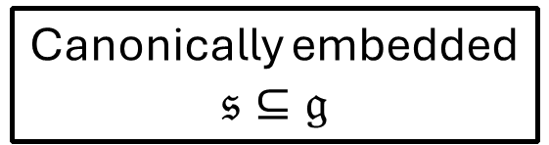
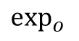
Sufficient criterion (Sagle ‘68, LN—Rodríguez-Vázquez)
$M$ naturally reductive, $𝔳⊆𝔭$ invariant under $R$ and $D$.
The subalgebra $𝔰={\left[𝔳,𝔳\right]}_{𝔨}⊕𝔳$ satisfies
$𝔰=\left(𝔰∩𝔨\right)⊕\left(𝔰∩𝔭\right)=𝔰_{𝔨}⊕𝔰_{𝔭}$.
The orbit $S⋅o$ is totally geodesic.
$$π_{𝔭}$$
Canonically embedded
$$𝔰⊆𝔤$$
$R$ and $D$-invariant
$$𝔳⊆𝔭$$
$$Lie$$
$o$-orbit
Totally geodesic
$Σ⊆M$, $o∈Σ$
$$\exp_{o}{ }$$

Slide 15
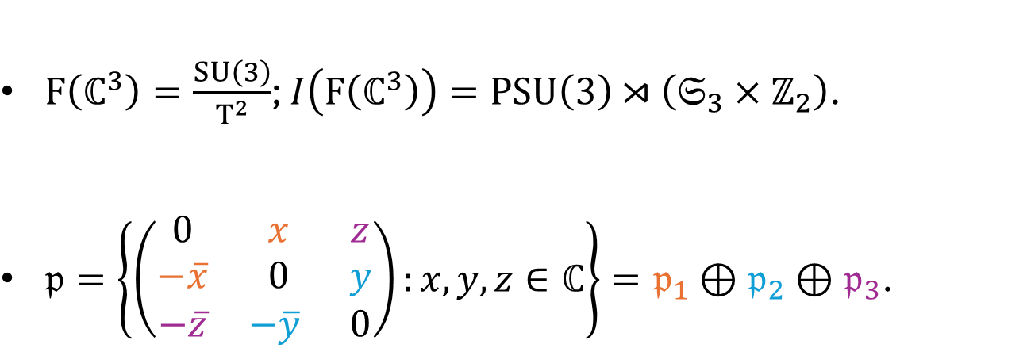

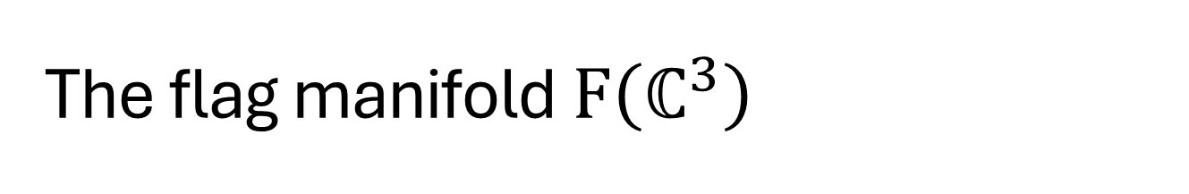


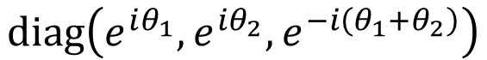
The flag manifold $F\left(ℂ^{3}\right)$
$F\left(ℂ^{3}\right)=\frac{SU\left(3\right)}{T^{2}}$; $I\left(F\left(ℂ^{3}\right)\right)=PSU\left(3\right)⋊\left(𝔖_{3}×ℤ_{2}\right)$.
$𝔭=\left\{\left(\begin{matrix}0 & x & z \\ −\overline{x} & 0 & y \\ −\overline{z} & −\overline{y} & 0\end{matrix}\right):x,y,z∈ℂ\right\}=𝔭_{1}⊕𝔭_{2}⊕𝔭_{3}$.
$$e^{i\left(θ_{1}−θ_{2}\right)}$$
$$diag\left(e^{iθ_{1}},e^{iθ_{2}},e^{−i\left(θ_{1}+θ_{2}\right)}\right)$$
$$e^{i\left(θ_{1}+2θ_{2}\right)}$$
$$e^{i\left({2θ}_{1}+θ_{2}\right)}$$

Slide 16
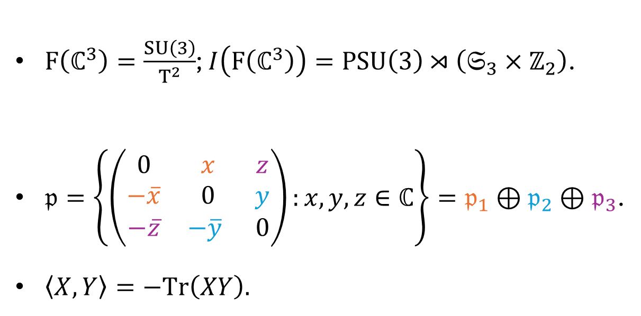
The flag manifold $F\left(ℂ^{3}\right)$
$F\left(ℂ^{3}\right)=\frac{SU\left(3\right)}{T^{2}}$; $I\left(F\left(ℂ^{3}\right)\right)=PSU\left(3\right)⋊\left(𝔖_{3}×ℤ_{2}\right)$.
$𝔭=\left\{\left(\begin{matrix}0 & x & z \\ −\overline{x} & 0 & y \\ −\overline{z} & −\overline{y} & 0\end{matrix}\right):x,y,z∈ℂ\right\}=𝔭_{1}⊕𝔭_{2}⊕𝔭_{3}$.
$\left\langle X,Y\right\rangle =−Tr\left(XY\right).$

Slide 17
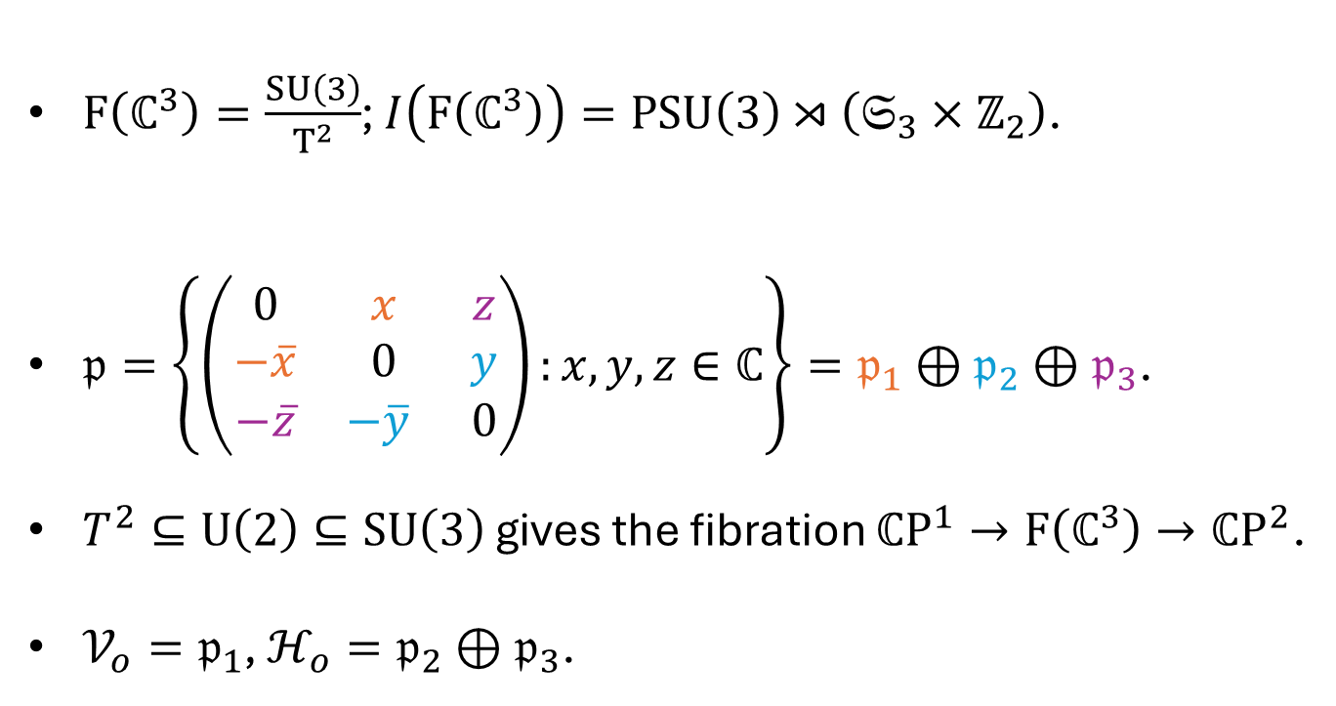
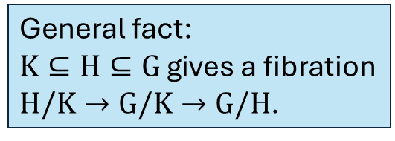
The flag manifold $F\left(ℂ^{3}\right)$
$F\left(ℂ^{3}\right)=\frac{SU\left(3\right)}{T^{2}}$; $I\left(F\left(ℂ^{3}\right)\right)=PSU\left(3\right)⋊\left(𝔖_{3}×ℤ_{2}\right)$.
$𝔭=\left\{\left(\begin{matrix}0 & x & z \\ −\overline{x} & 0 & y \\ −\overline{z} & −\overline{y} & 0\end{matrix}\right):x,y,z∈ℂ\right\}=𝔭_{1}⊕𝔭_{2}⊕𝔭_{3}$.
$T^{2}⊆U\left(2\right)⊆SU\left(3\right)$ gives the fibration $ℂP^{1}→F\left(ℂ^{3}\right)→ℂP^{2}$.
$𝒱_{o}=𝔭_{1}$, $ℋ_{o}=𝔭_{2}⊕𝔭_{3}$.
General fact:
$K⊆H⊆G$ gives a fibration
$H/K→G/K→G/H$.

Slide 18
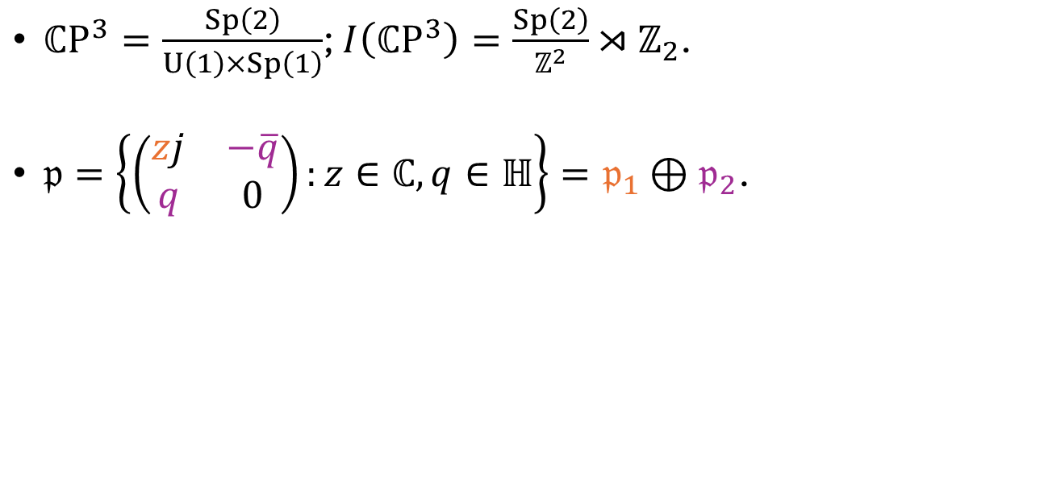
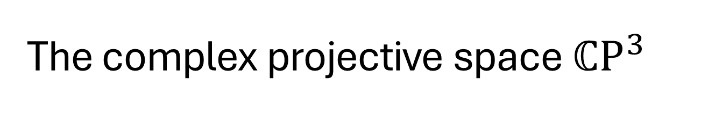

The complex projective space $ℂP^{3}$
$ℂP^{3}=\frac{Sp\left(2\right)}{U\left(1\right)×Sp\left(1\right)}$; $I\left(ℂP^{3}\right)=\frac{Sp\left(2\right)}{ℤ^{2}}⋊ℤ_{2}$.
$𝔭=\left\{\left(\begin{matrix}zj & −\overline{q} \\ q & 0\end{matrix}\right):z∈ℂ,q∈ℍ\right\}=𝔭_{1}⊕𝔭_{2}$.
$$\left(λ,μ\right)⋅z=λ^{2}z \\ \left(λ,μ\right)⋅q=μq\overline{λ}$$

Slide 19
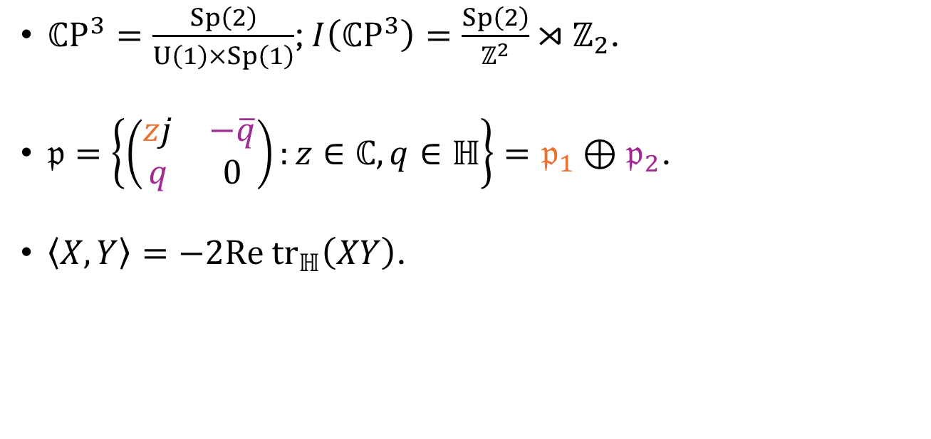
The complex projective space $ℂP^{3}$
$ℂP^{3}=\frac{Sp\left(2\right)}{U\left(1\right)×Sp\left(1\right)}$; $I\left(ℂP^{3}\right)=\frac{Sp\left(2\right)}{ℤ^{2}}⋊ℤ_{2}$.
$𝔭=\left\{\left(\begin{matrix}zj & −\overline{q} \\ q & 0\end{matrix}\right):z∈ℂ,q∈ℍ\right\}=𝔭_{1}⊕𝔭_{2}$.
$\left\langle X,Y\right\rangle =−2Re tr_{ℍ}\left(XY\right)$.

Slide 20
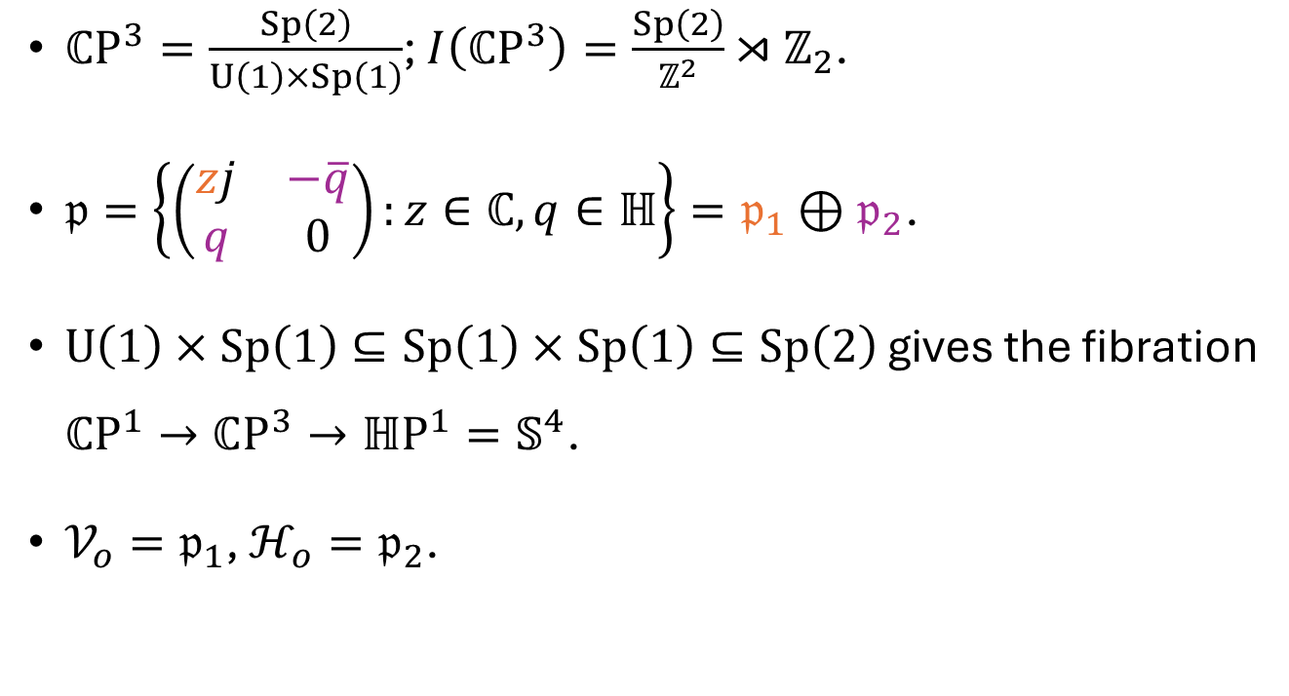
The complex projective space $ℂP^{3}$
$ℂP^{3}=\frac{Sp\left(2\right)}{U\left(1\right)×Sp\left(1\right)}$; $I\left(ℂP^{3}\right)=\frac{Sp\left(2\right)}{ℤ^{2}}⋊ℤ_{2}$.
$𝔭=\left\{\left(\begin{matrix}zj & −\overline{q} \\ q & 0\end{matrix}\right):z∈ℂ,q∈ℍ\right\}=𝔭_{1}⊕𝔭_{2}$.
$U\left(1\right)×Sp\left(1\right)⊆Sp\left(1\right)×Sp\left(1\right)⊆Sp\left(2\right)$ gives the fibration $ℂP^{1}→ℂP^{3}→ℍP^{1}=𝕊^{4}$.
$𝒱_{o}=𝔭_{1}$, $ℋ_{o}=𝔭_{2}$.

Slide 21
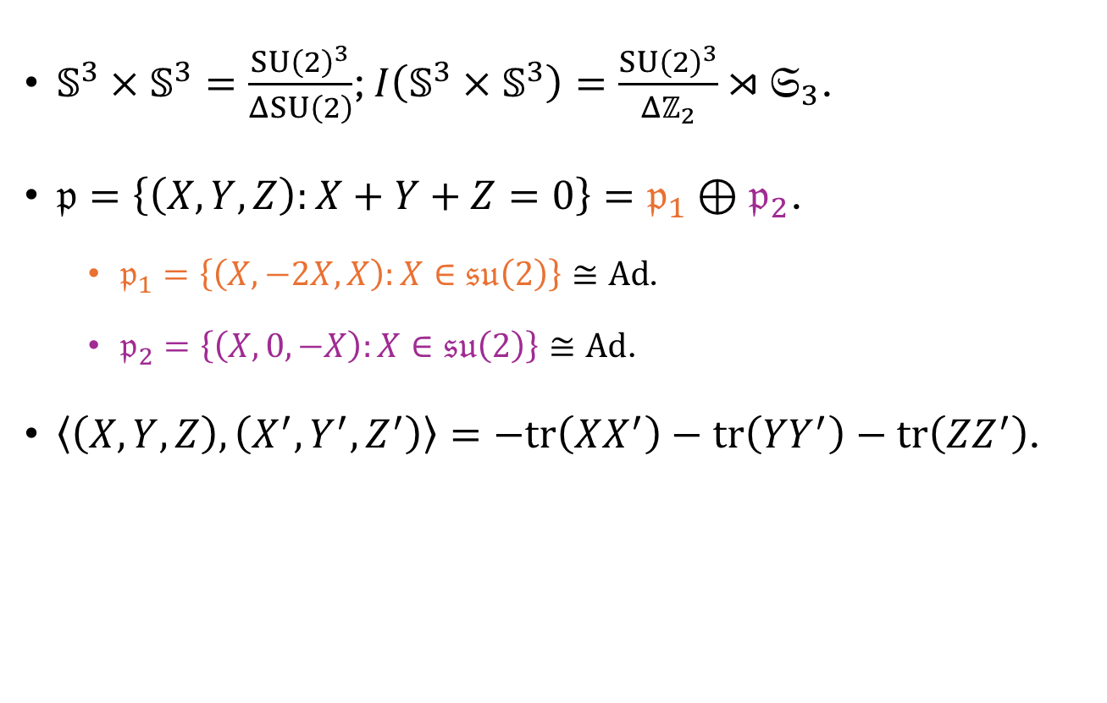
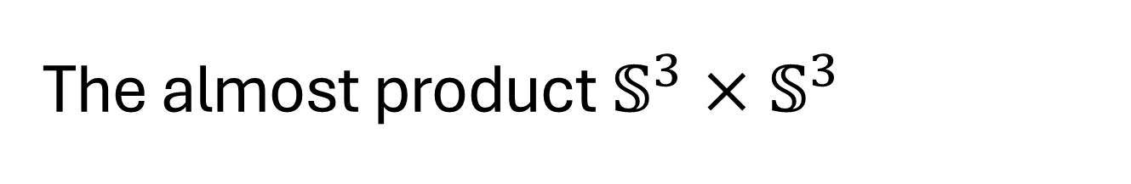
The almost product $𝕊^{3}×𝕊^{3}$
$𝕊^{3}×𝕊^{3}=\frac{SU{\left(2\right)}^{3}}{ΔSU\left(2\right)}$; $I\left(𝕊^{3}×𝕊^{3}\right)=\frac{SU{\left(2\right)}^{3}}{Δℤ_{2}}⋊𝔖_{3}$.
$𝔭=\left\{\left(X,Y,Z\right):X+Y+Z=0\right\}=𝔭_{1}⊕𝔭_{2}$.
$𝔭_{1}=\left\{\left(X,−2X,X\right):X∈𝔰𝔲\left(2\right)\right\}≅Ad$.
$𝔭_{2}=\left\{\left(X,0,−X\right):X∈𝔰𝔲\left(2\right)\right\}≅Ad$.
$\left\langle \left(X,Y,Z\right),\left(X^{′},Y^{′},Z^{′}\right)\right\rangle =−tr\left(XX^{′}\right)−tr\left(YY^{′}\right)−tr\left({ZZ}^{′}\right)$.

Slide 22

The almost product $𝕊^{3}×𝕊^{3}$
$𝕊^{3}×𝕊^{3}=\frac{SU{\left(2\right)}^{3}}{ΔSU\left(2\right)}$; $I\left(𝕊^{3}×𝕊^{3}\right)=\frac{SU{\left(2\right)}^{3}}{Δℤ_{2}}⋊𝔖_{3}$.
$𝔭=\left\{\left(X,Y,Z\right):X+Y+Z=0\right\}=𝔭_{1}⊕𝔭_{2}$.
$ΔSU\left(2\right)⊆Δ_{13}SU\left(2\right)×SU{\left(2\right)}_{2}⊆SU{\left(2\right)}^{3}$ gives the fibration $𝕊^{3}→𝕊^{3}×𝕊^{3}→𝕊^{3}$.
$𝒱_{o}=𝔭_{1}$, $ℋ_{o}=𝔭_{2}$.

Slide 23


Low codimension
Theorem (Nikolayevsky ‘15)
$M$ simply connected, irreducible, compact and homogeneous.
If there exists a totally geodesic hypersurface $Σ⊆M$, then $M=𝕊^{n}$.
Corollary
$F\left(ℂ^{3}\right)$, $ℂP^{3}$ and $𝕊^{3}×𝕊^{3}$ have no totally geodesic hypersurfaces.

Slide 24


Low codimension
Theorem (Nikolayevsky ‘15)
$M$ simply connected, irreducible, compact and homogeneous.
If there exists a totally geodesic hypersurface $Σ⊆M$, then $M=𝕊^{n}$.
Theorem
$F\left(ℂ^{3}\right)$, $ℂP^{3}$ and $𝕊^{3}×𝕊^{3}$ have no totally geodesic submanifolds of codimension $≤2$.

Slide 25

Dimension three
Ambient | Submanifold | Orbit of
$$F\left(ℂ^{3}\right)$$ | $$F\left(ℝ^{3}\right)=𝕊^{3}\left(2\sqrt{2}\right)/Q_{8}$$ | $$SO\left(3\right)$$
 | $$𝕊_{ℂ,1/4 }^{3}\left(2\right)$$ | $$SU\left(2\right)$$
$$ℂP^{3}$$ | $$ℝP_{ℂ,1/2}^{3}\left(\sqrt{2}\right)$$ | $$SU{\left(2\right)}^{j}$$
$$𝕊^{3}×𝕊^{3}$$ | $$𝕊^{3}\left(2/\sqrt{3}\right)$$ | $$SU{\left(2\right)}_{2}$$
 | $$𝕊_{ℂ,1/3 }^{3}\left(2\right)$$ | $$Δ_{13}SU\left(2\right)×SU{\left(2\right)}_{2}$$
All of them are Lagrangian.

Slide 26


Dimension two in ${F(ℂ}^{3})$
Submanifold | Orbit of | Relationship with $J$
$$T_{A}=ℝ^{2}/A$$ | $$T^{2}$$ | Almost complex
$${ℂP^{1}=𝕊}^{2}\left(1/\sqrt{2}\right)$$ | $$U\left(2\right)$$ | Almost complex
$$𝕊^{2}\left(\sqrt{2}\right)$$ | $$SO\left(3\right)$$ | Almost complex
$$ℝP^{2}\left(2\sqrt{2}\right)→F\left(ℝ^{3}\right)$$ | Inhomogeneous | Totally real

Slide 27



Dimension two in ${F(ℂ}^{3})$
Submanifold | Orbit of | Relationship with $J$
$$T_{A}=ℝ^{2}/A$$ | $$T^{2}$$ | Almost complex
$$A=ℤ−span\left\{\left(0,\frac{2\sqrt{2}π}{\sqrt{3}}\right),\left(\sqrt{2}π,\frac{\sqrt{2}}{\sqrt{3}}π\right)\right\}$$

Slide 28


Dimension two in ${F(ℂ}^{3})$
Submanifold | Orbit of | Relationship with $J$
$$T_{A}=ℝ^{2}/A$$ | $$T^{2}$$ | Almost complex

Slide 29


Dimension two in $ℂP^{3}$
Submanifold | Orbit of | Relationship with $J$
$$𝕊^{2}\left(1/\sqrt{2}\right)$$ | $$Sp{\left(1\right)}_{f}$$ | Almost complex
$$𝕊^{2}\left(1\right)$$ | $$SU\left(2\right)$$ | Almost complex
$$𝕊^{2}\left(\sqrt{5}\right)$$ | $$SU{\left(2\right)}_{Λ_{3}}$$ | Almost complex
$Λ_{3}=Sym^{3}\left(ℂ^{2}\right)$: four-dimensional irrep. of $SU\left(2\right)$.

Slide 30


Dimension two in $𝕊^{3}×𝕊^{3}$
Submanifold | Orbit of | Relationship with $J$
$$T_{B}=ℝ^{2}/B$$ | $$T⊆U{\left(1\right)}^{3}$$ | Almost complex
$$𝕊^{2}\left(\sqrt{3}/\sqrt{2}\right)$$ | $$ΔSU\left(2\right)$$ | Almost complex
$$𝕊^{2}⊆𝕊^{3}\left(2/\sqrt{3}\right)$$ | $$H⊆Δ_{13}SU\left(2\right)×SU{\left(2\right)}_{2}$$ | Totally real

Slide 31



Dimension two in $𝕊^{3}×𝕊^{3}$
Submanifold | Orbit of | Relationship with $J$
$$T_{B}=ℝ^{2}/B$$ | $$T⊆U{\left(1\right)}^{3}$$ | Almost complex
$$B=ℤ−span\left\{\left(\frac{4π}{\sqrt{3}},0\right),\left(\frac{2π}{\sqrt{3}},2π\right)\right\}$$

Slide 32


Dimension two in $𝕊^{3}×𝕊^{3}$
Submanifold | Orbit of | Relationship with $J$
$$T_{B}=ℝ^{2}/B$$ | $$T⊆U{\left(1\right)}^{3}$$ | Almost complex

Slide 33

Ambient | Submanifold | Orbit of | Relationship with $J$
$$F\left(ℂ^{3}\right)$$ | $$F\left(ℝ^{3}\right)=𝕊^{3}\left(2\sqrt{2}\right)/Q_{8}$$ | $$SO\left(3\right)$$ | Lagrangian
 | $$𝕊_{ℂ,1/4 }^{3}\left(2\right)$$ | $$SU\left(2\right)$$ | Lagrangian
 | $$T_{A}$$ | $$T^{2}$$ | Almost complex
 | $${ℂP^{1}=𝕊}^{2}\left(1/\sqrt{2}\right)$$ | $$U\left(2\right)$$ | Almost complex
 | $$𝕊^{2}\left(\sqrt{2}\right)$$ | $$SO\left(3\right)$$ | Almost complex
 | $$ℝP^{2}\left(2\sqrt{2}\right)→F\left(ℝ^{3}\right)$$ | Inhomogeneous | Totally real
$$ℂP^{3}$$ | $$ℝP_{ℂ,1/2}^{3}\left(\sqrt{2}\right)$$ | $$SU{\left(2\right)}^{j}$$ | Lagrangian
 | $$𝕊^{2}\left(1/\sqrt{2}\right)$$ | $$Sp{\left(1\right)}_{f}$$ | Almost complex
 | $$𝕊^{2}\left(1\right)$$ | $$SU\left(2\right)$$ | Almost complex
 | $$𝕊^{2}\left(\sqrt{5}\right)$$ | $$SU{\left(2\right)}_{Λ_{3}}$$ | Almost complex
$$𝕊^{3}×𝕊^{3}$$ | $$𝕊^{3}\left(2/\sqrt{3}\right)$$ | $$SU{\left(2\right)}_{2}$$ | Lagrangian
 | $$𝕊_{ℂ,1/3 }^{3}\left(2\right)$$ | $$Δ_{13}SU\left(2\right)×SU{\left(2\right)}_{2}$$ | Lagrangian
 | $$T_{B}$$ | $$T⊆U{\left(1\right)}^{3}$$ | Almost complex
 | $$𝕊^{2}\left(\sqrt{3}/\sqrt{2}\right)$$ | $$ΔSU\left(2\right)$$ | Almost complex
 | $$𝕊^{2}⊆𝕊^{3}\left(2/\sqrt{3}\right)$$ | $$H⊆Δ_{13}SU\left(2\right)×SU{\left(2\right)}_{2}$$ | Totally real

